Slide 1

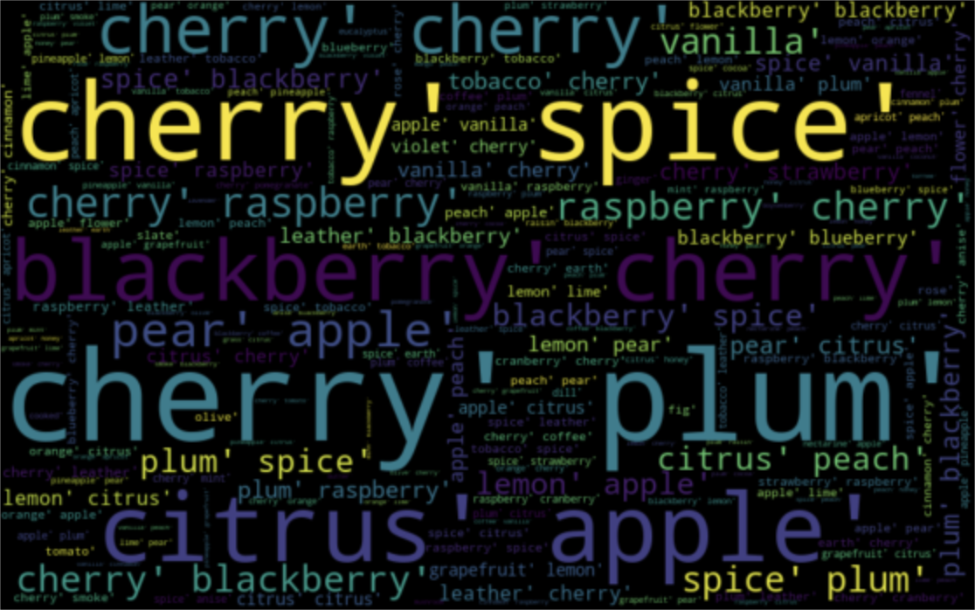
Wine review
Cate Soane, Toni Anderson, Alex Schackmuth

Slide 2
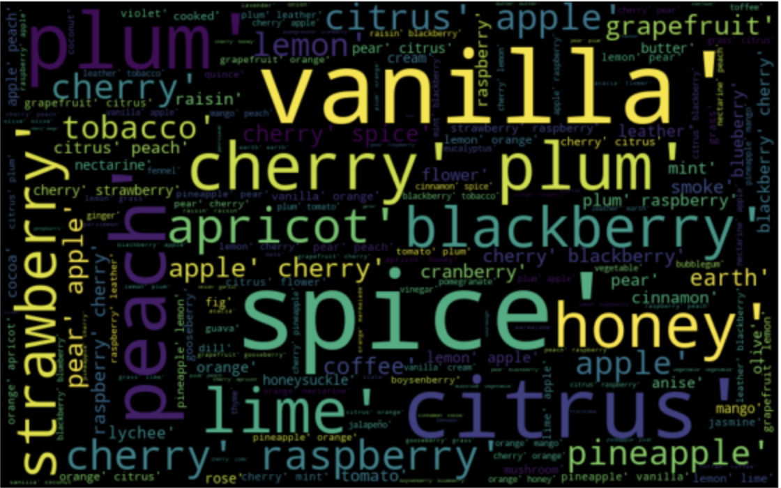
Why?
How is price determined?
Are there any correlations between
Region
Score
Year
Word Count etc.

Slide 3
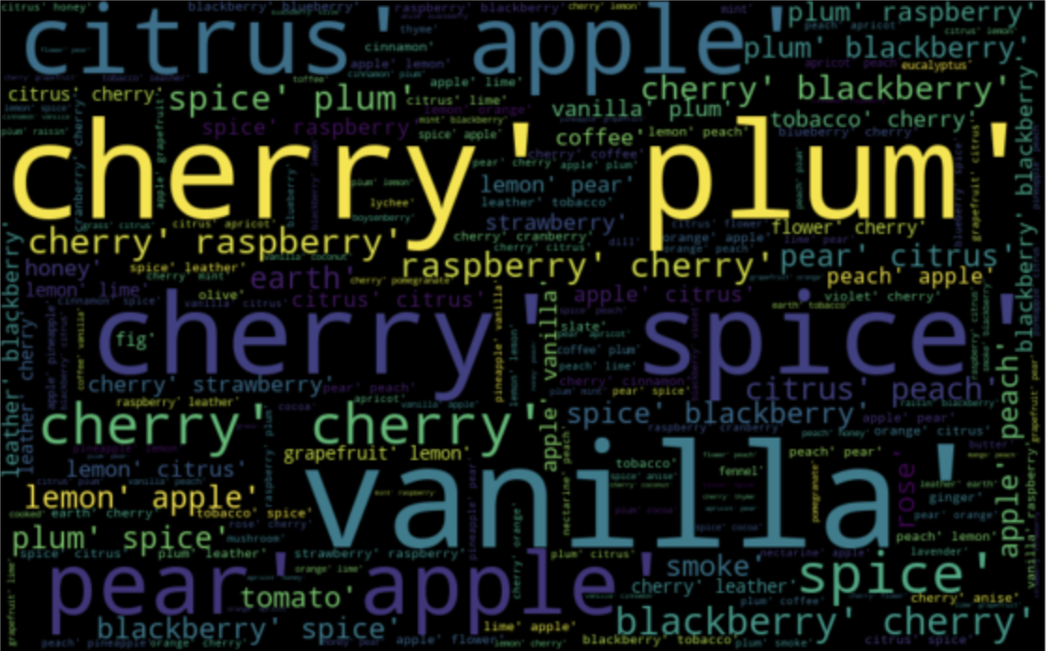
Data Collection
Kaggle:
CSV containing scraped Twitter data
Flavor Notes:
Found on separate website

Slide 4
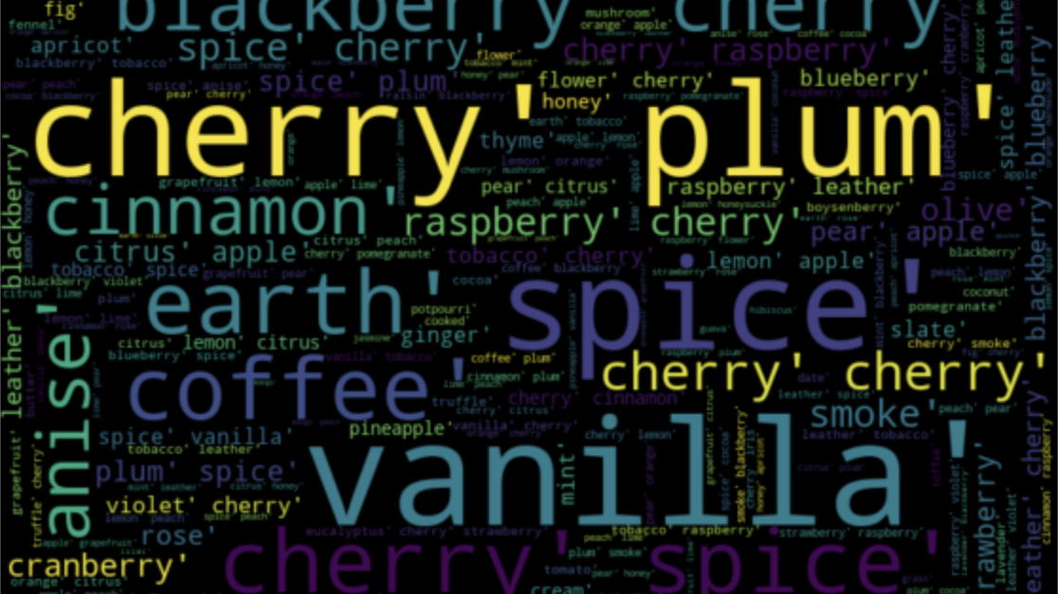
Data Cleaning
Removed columns
Filtered description
Binned scores
Grouped by continent

Slide 5
Technology used
Python
Jupyter Notebook
Machine Learning
Tableau

Slide 6
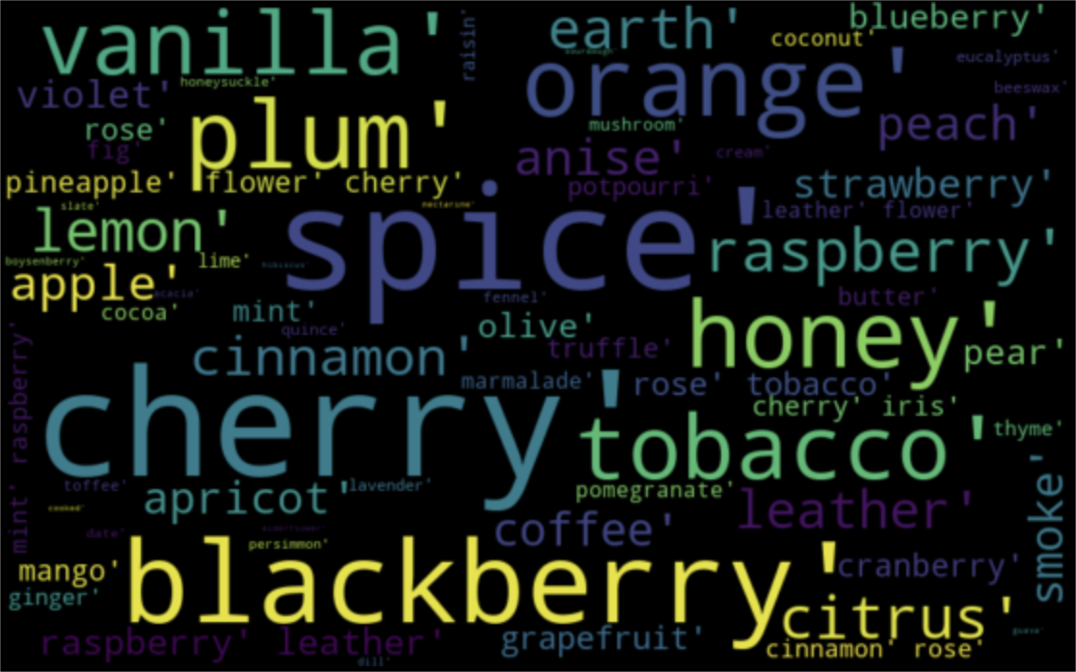
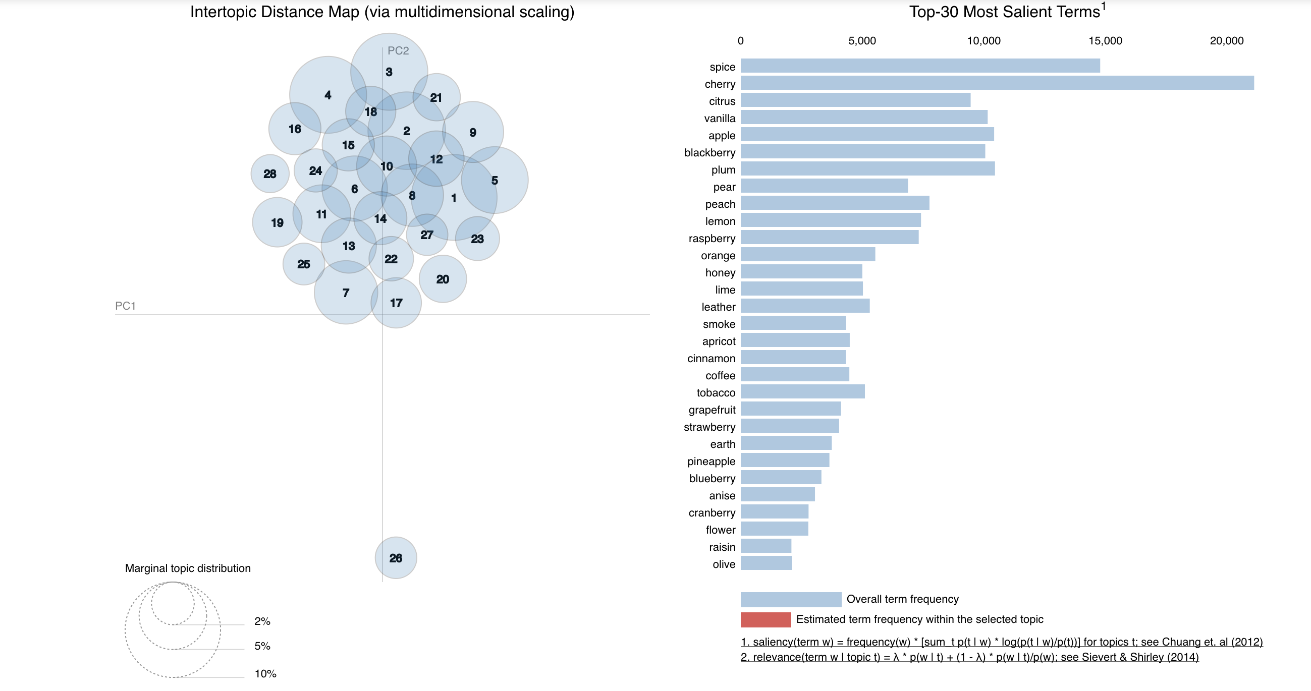
Data Exploration: Clustering
Notes:
Using only the words in our flavor list..
Our interactive visualization tool for topic models fit using LDA
To use the visualization tool, click a circle in the left panel to select a topic, and the bar chart in the right panel will display the 30 most relevant terms for the selected topic, where we define the relevance of a term to a topic. The red bars represent the frequency of a term in a given topic, and the blue bars represent a term's frequency across the entire collection of written texts ( in our case the reviews ).
Topic modeling is a type of statistical modeling for discovering the abstract “topics” that occur in a collection of documents. Latent Dirichlet Allocation (LDA) is an example of topic model and is used to classify text in a document to a particular topic.
Size stands for marginal topic distribution

Slide 7
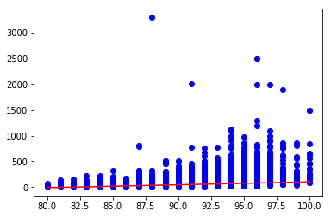
OLS Regression: Price vs. Score
Bivariate model used to assess correlation in exploratory analysis

Slide 8
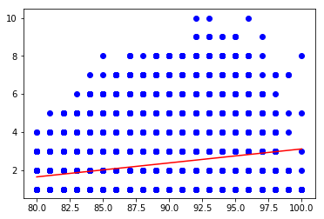
OLS Regression: Flavor Notes vs. Score

Slide 9
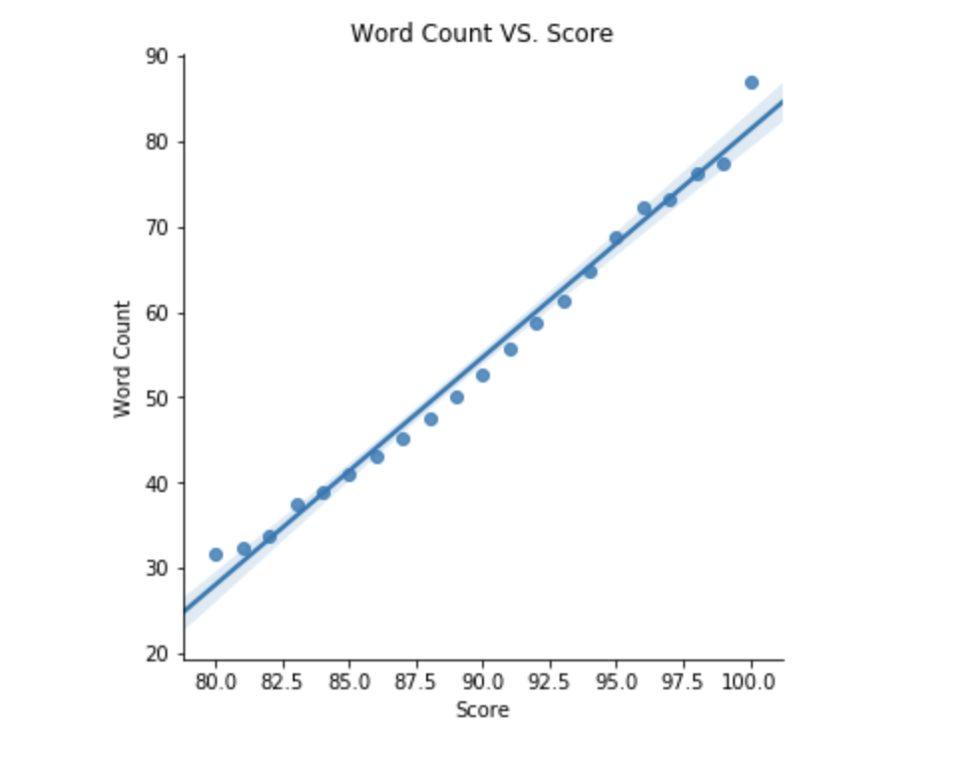
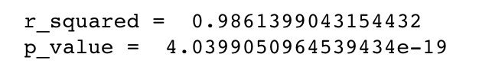
Regression: Review Length vs. Score
Notes:
Used regression analysis…
Discovered that we have a near perfect correlation between the word count in a review and it’s score.
This suggests that the better the wine the more time and detail someone puts into a review

Slide 10
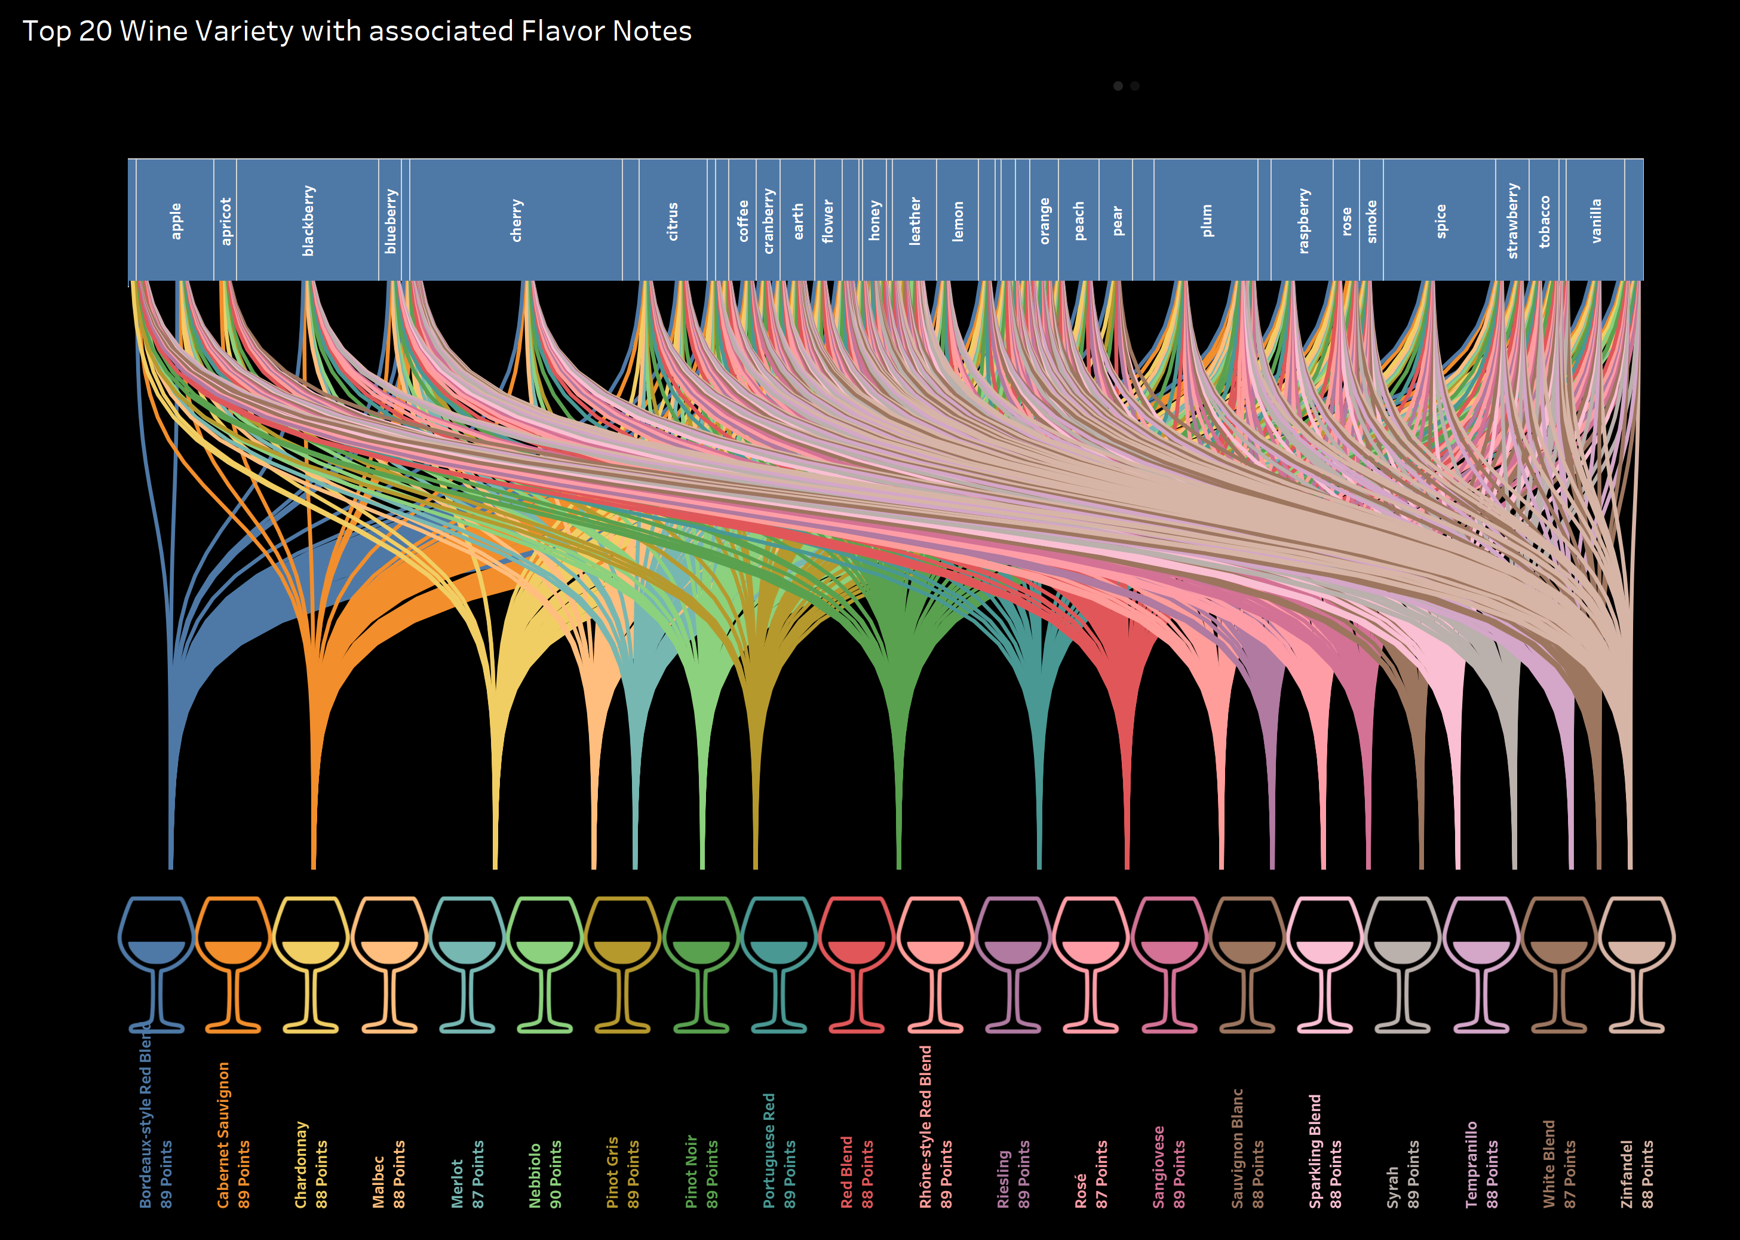
Top 20 wine Variety & Flavor Notes
Sankey Chart displaying the wine varieties and its associated Flavor Notes

Slide 11
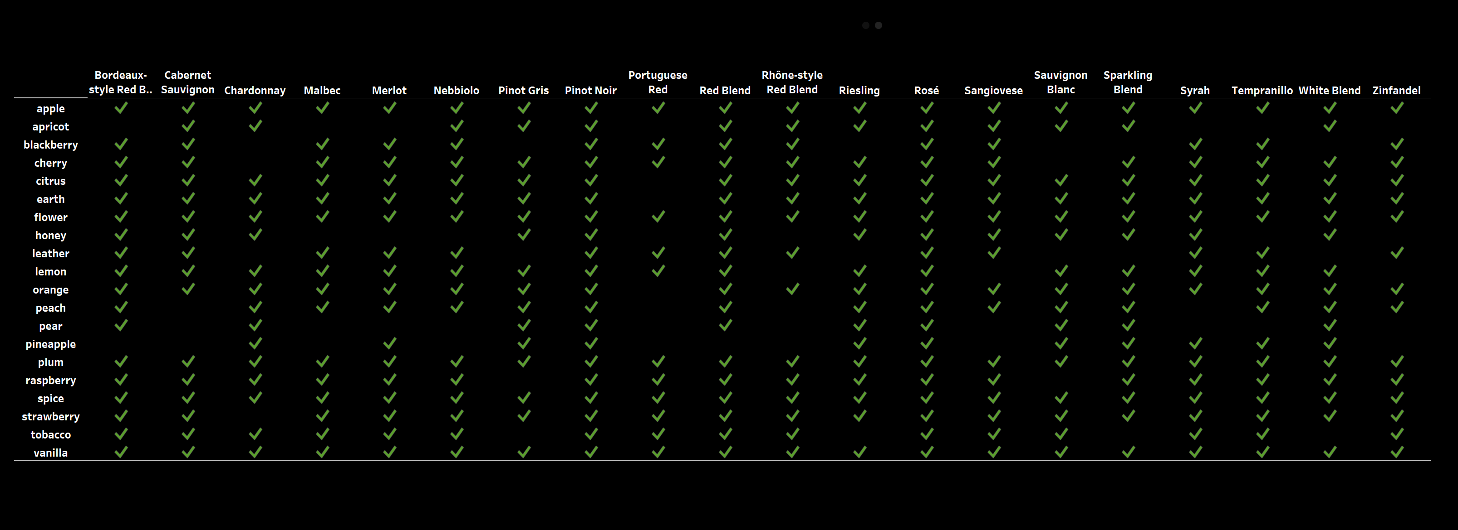
Flavor Notes comparison across wine variety

Slide 12
DEMO
Notes:
This will display the technical analysis of the Wine Data in Tableau and Jupyter Notebook..

